Slide 1
Impact of Lifestyle and Mental Health on Academics for International Students Team Members: Vignesh RB (002322663) Abhishek Kothari(002369703)

Slide 2









Expectations vs Reality of International Students
Expectations
Reality
I'll make friends from every continent and attend fun parties!
I'll crush my coursework and have plenty of free time for hobbies!
The city is packed with opportunities. I'll have an internship in no time!
Group project? That counts as a social event, right?
Sleep is a luxury, and I now dream in Python code.
Wake up to rejection mails everyday cheerfully informing us that the company found a better candidate.

Slide 3



PROJECT MOTIVATION
Challenges for International Students
Over 60% of college students met the criteria for at least one mental health problem during the 2020–2021 academic year. [1]
Nearly two-thirds of international students experience loneliness and isolation, especially within the first few months of arrival. [2]
Approximately 28.71% of international students report experiencing anxiety symptoms, often linked to academic pressures and financial concerns. [3]

Slide 4
PROJECT GOALS
1) Understand Key Relationships:
Explore how lifestyle choices and mental health factors influence academic performance.
2) Enhance Well-Being:
Identify actionable strategies to reduce stress, foster mental well-being, and support students facing challenges like isolation and discrimination.
3) Empower Support Systems:
Provide data-driven insights to help universities and student organizations develop effective programs and policies for international students.

Slide 5
DATA AND METHODOLOGY
Dataset
The initial dataset from Kaggle contained approximately 100 rows.
Expanded to 1,000 rows using advanced synthetic data generation techniques for deeper analysis.
Originally structured as a single table, it was reorganized into three logical tables:
-Students: Demographics and academic details.
-MentalHealth: Anxiety, depression, and related factors.
-Lifestyle: Sleep patterns, CGPA, and stress-relief activities.

Slide 6
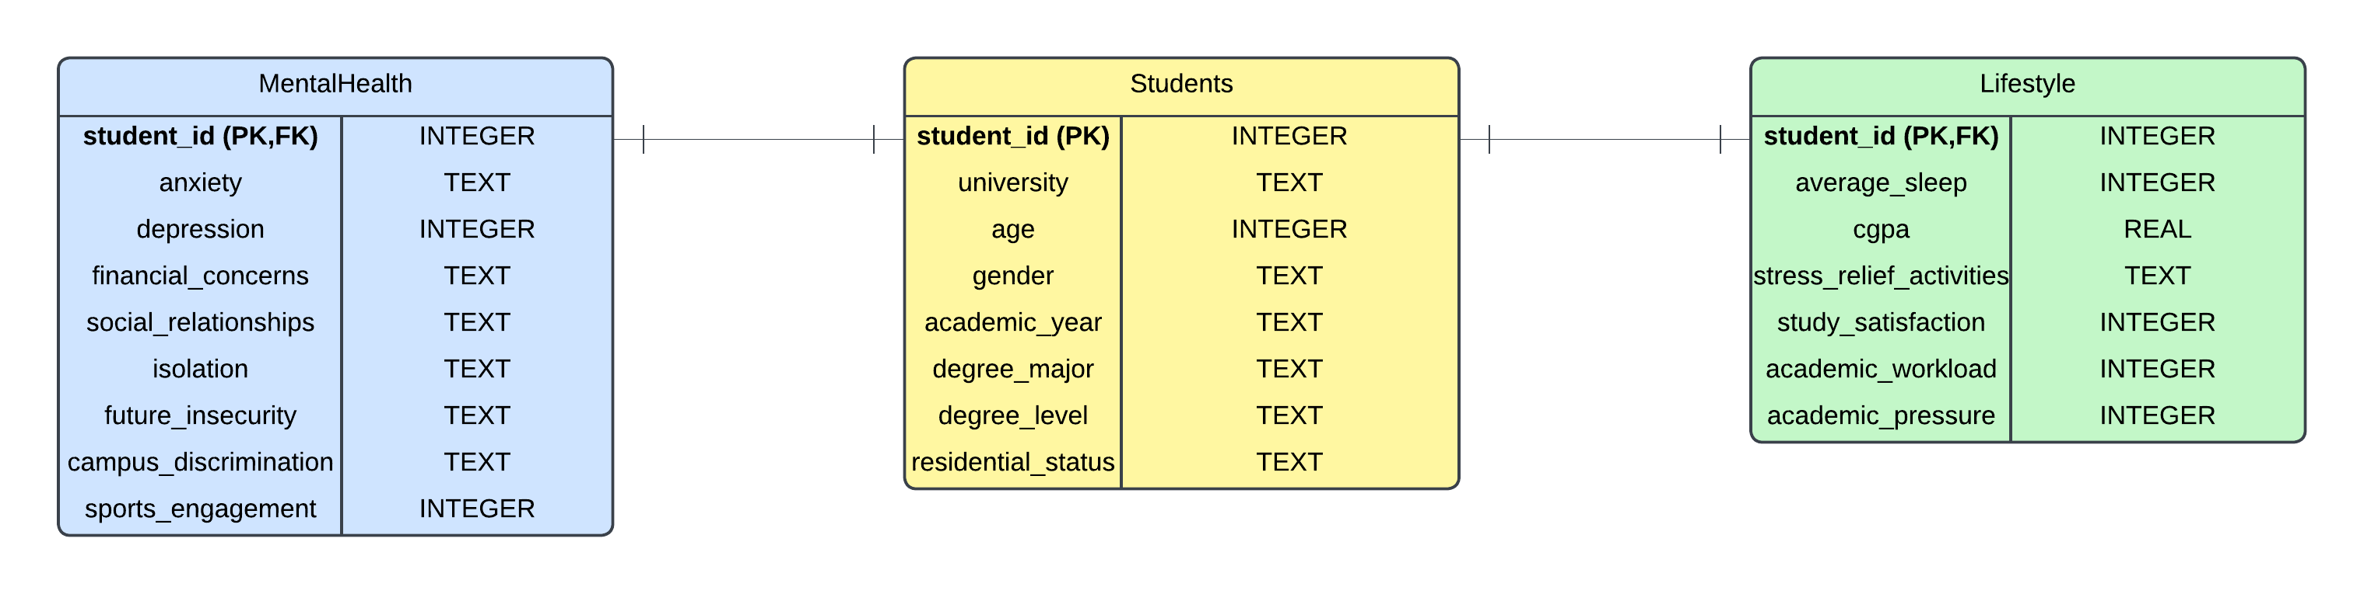
ER DIAGRAM

Slide 7
RESEARCH QUESTIONS
Focus Areas:
Identifying the links between lifestyle, mental health, and academics.
Examples of Key Questions:
Major-Specific Trends:
-Which student majors report the highest levels of depression?
Financial Concerns:
-How do financial concerns impact mental health and sleep quality?
Sports and Performance:
-What is the effect of sports participation on mental well-being and CGPA?
Additional Areas of Analysis:
Gender differences in mental health and academic success.
Impact of residential status on overall well-being.
The relationship between academic workload and study satisfaction.

Slide 8





ANALYSIS PROCESS
Synthetic Data Generation
Data Cleaning and Preprocessing
Database Design
Queries for insights
Visualization

Slide 9
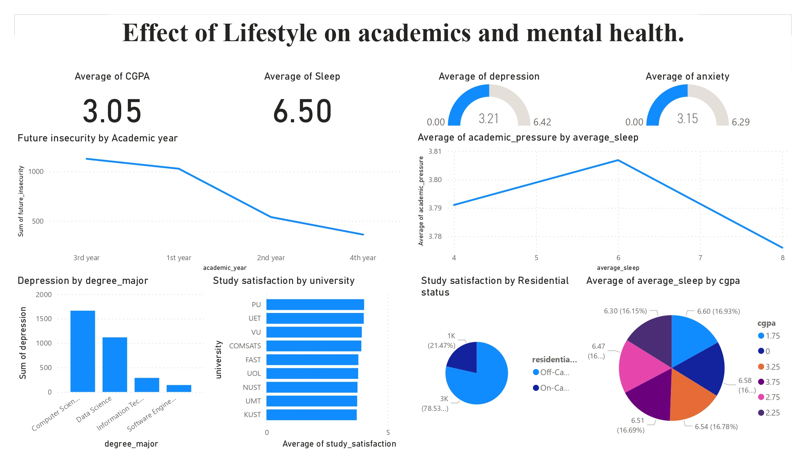
Dashboard: Overview of the insights:

Slide 10
Results for mental health issues:
Key Findings:
Stress Relief Activities:
Students engaging in sports and fitness report lower levels of anxiety and depression.
Engaging and social activities help mitigate future insecurity and isolation.
Sleep Patterns:
Students with average sleep above 7 hours show significantly lower rates of depression.
Financial Concerns and Mental Health:
Financial insecurity strongly correlates with higher anxiety and depression.
Insight: A balanced lifestyle incorporating adequate sleep and stress-relief activities positively impacts mental health.

Slide 11
Results for academic issues:
Key Findings:
Sleep and CGPA:
Students with better sleep patterns consistently achieve higher academic performance (measured via CGPA).
Study Satisfaction:
High academic satisfaction correlates with lower academic pressure and manageable workload.
Stress Management:
Students actively engaging in stress relief activities maintain better focus and CGPA despite workload.
Insight: Healthy lifestyle choices, including sleep and stress management, directly contribute to academic success.

Slide 12
Concluding Insights:
Mental Health and Academics are Interlinked:
A healthier mind leads to better academic outcomes.
Addressing lifestyle challenges can improve both mental health and academic performance.
Recommendations for Institutions:
Promote stress-relief programs and awareness about sleep importance.
Provide financial and emotional support systems for students.

Slide 13
Thank You

